Slide 1


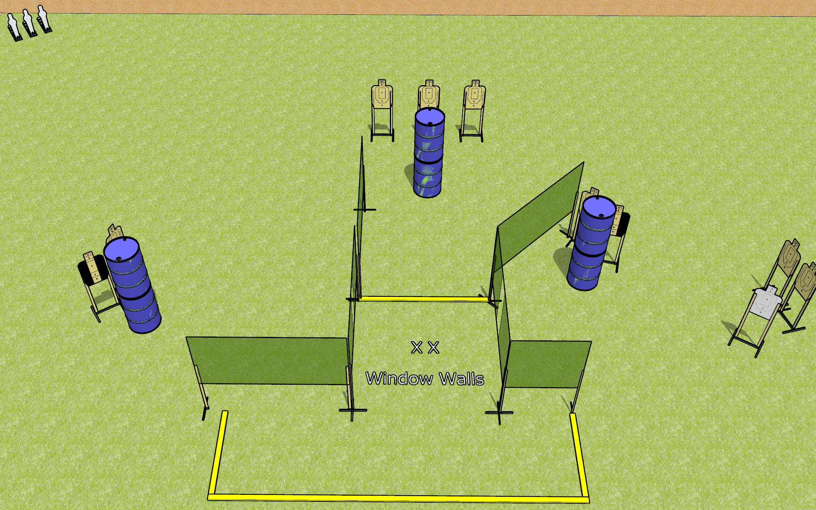
 | Dothan Gun Club – USPSA Match Windows Course Designer : Drew Coleman
Round Count 21 rounds 9 USPSA 3 mini poppers
Equipment List 9 wall feet 2 medium fault lines 2 tuxedos

Slide 2
Windows
Written Stage Briefing
Windows is a 21 round, 105 point, Comstock course of fire. There are 9 USPSA targets and 3 mini poppers. The best 2 hits on paper will score, and steel must fall to score. The start signal is audible
Handgun start position is both feet on X’s, wrists below belt. Handgun is loaded and holstered.
PCC start position is both feet on X’s, stock on belt. Loaded carbine is held with both hands, safety on.
On start signal, engage targets as they become available from within the shooting area.

